Slide 1
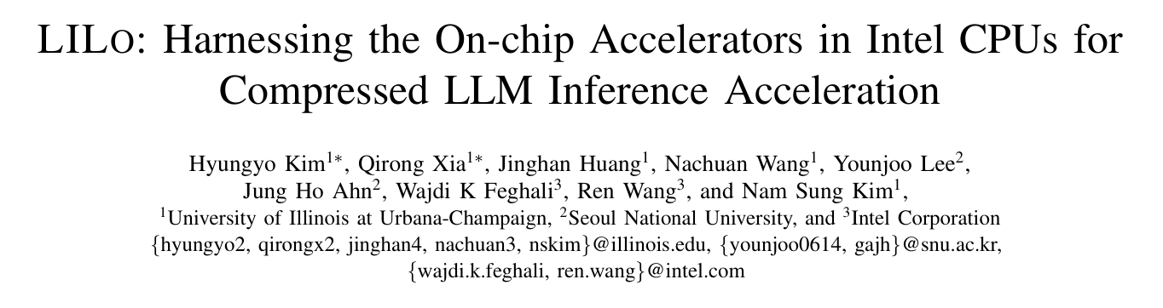
HPCA 2026

Slide 2
Ⅰ Introduction
Ⅱ Backgroud and Motivation
Ⅲ Methodology
Ⅳ Results
Ⅴ Conclusions

Slide 3
Ⅰ Introduction

Slide 4
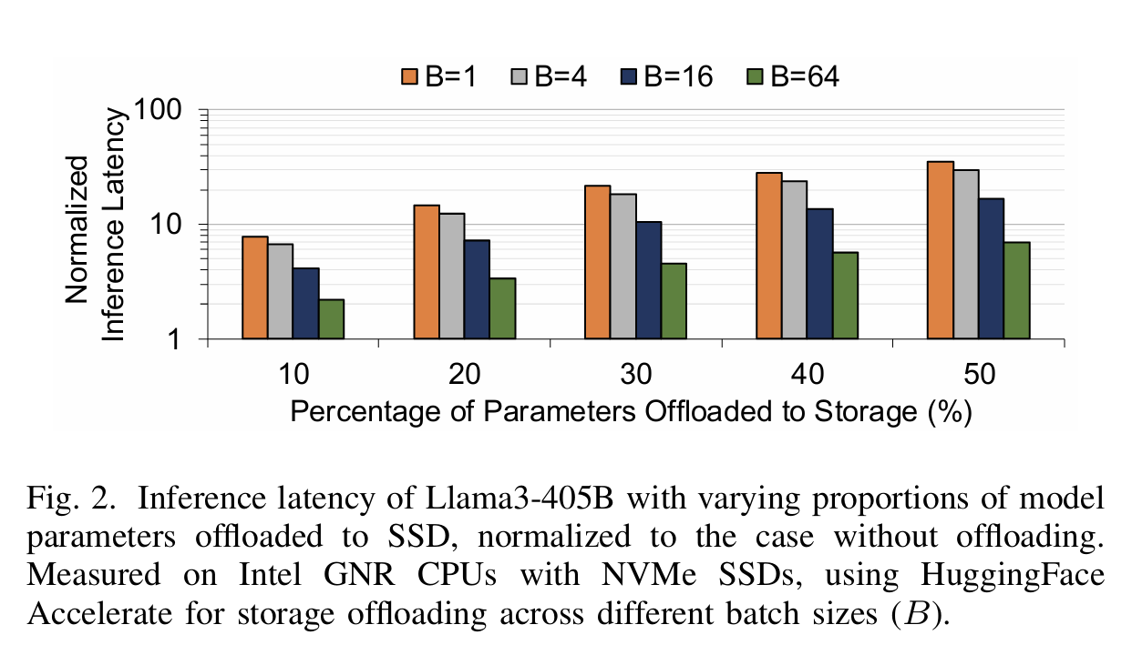
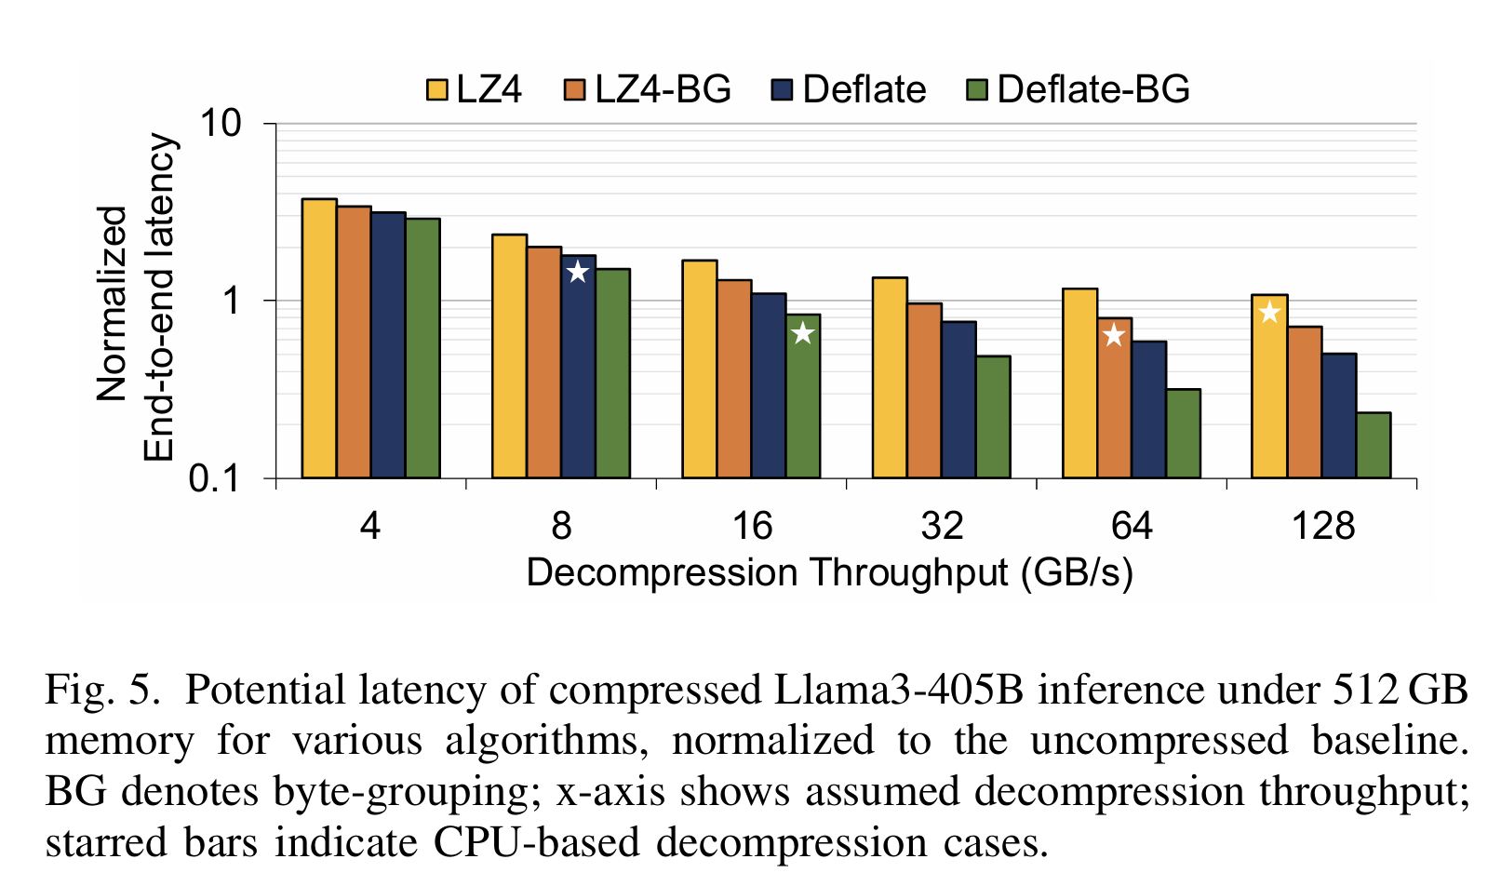
Research Background & Core Problem
LLM parameter explosion (Llama3-405B, DeepSeek-R1) → CPU memory cannot fit full models → storage offloading to SSD is mandatory
Fatal bottleneck: SSD is 100× slower than DRAM → offloading increases inference latency by 8–35×, making deployment impractical
Limitation of existing solutions: Pure software decompression is too slow → compression benefits are completely offset by decompression overhead → only 1.2× speedup at best

Slide 5
Ⅱ Backgroud and Motivation

Slide 6
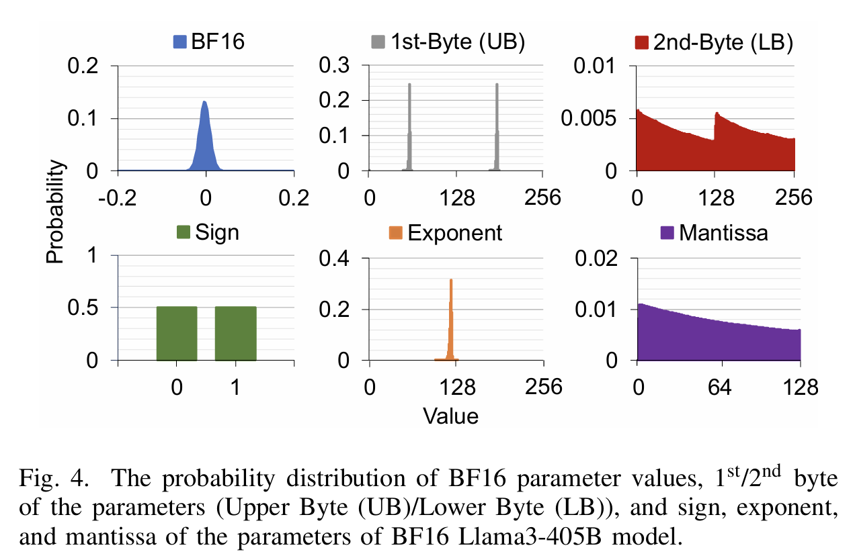
Key Insight: BF16 Parameters Are Naturally Compressible
Dominant LLM parameter format: BF16 (Brain Float 16)
Structure: 1 sign bit + 8 exponent bits + 7 mantissa bits
Split into Upper Byte (UB) and Lower Byte (LB)
Core observation from the paper:
UB: Highly concentrated distribution (99% of values are identical) → extremely low entropy, highly compressible
LB: Almost uniform distribution → no compression gain
Result: Compressing only UB achieves 33% lossless compression with zero accuracy loss

Slide 7
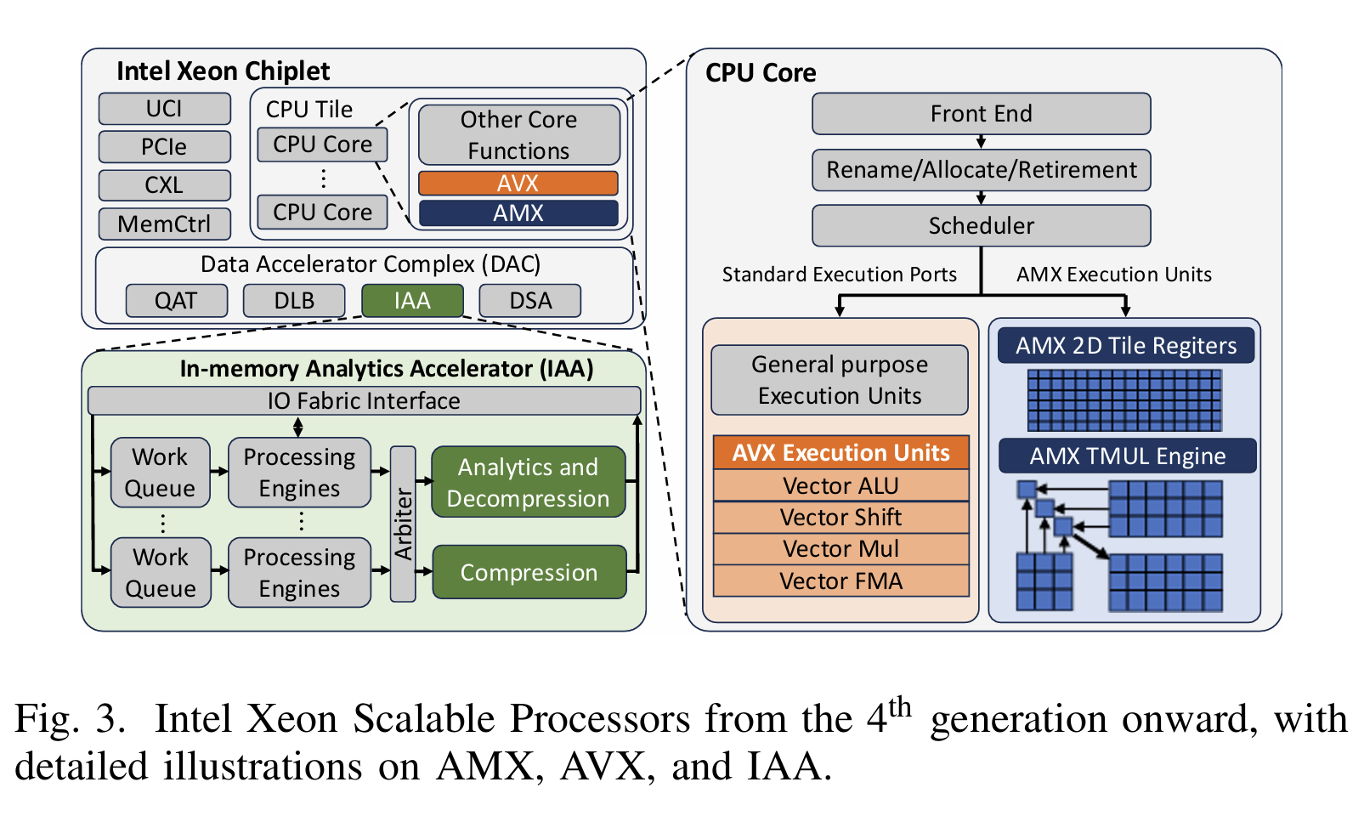
Intel On-Chip Accelerators (Hardware Foundation)
Three independent, physically isolated accelerators on 6th Gen Intel Xeon (Granite Rapids):
IAA (In-memory Analytics Accelerator): Dedicated hardware for Deflate compression/decompression → 32 parallel decompression engines per socket
AVX-512 (Advanced Vector Extensions): 512-bit vector execution units inside CPU cores → optimized for byte-level operations
AMX (Advanced Matrix Extensions): Dedicated matrix multiplication units → accelerates LLM inference compute
Critical property: All three accelerators operate independently with no resource contention

Slide 8
Motivation & Limitations of Existing Work
Three critical limitations of existing compressed inference on CPUs:
Pure CPU decompression is too slow → compression benefits are offset
Decompression, reconstruction, and compute run sequentially → low hardware utilization
Generic compression is inefficient for MoE models → 97% of parameters are rarely accessed
LILO's goal: Orchestrate these three accelerators into a parallel pipeline to eliminate decompression overhead

Slide 9
Ⅲ Methodology

Slide 10
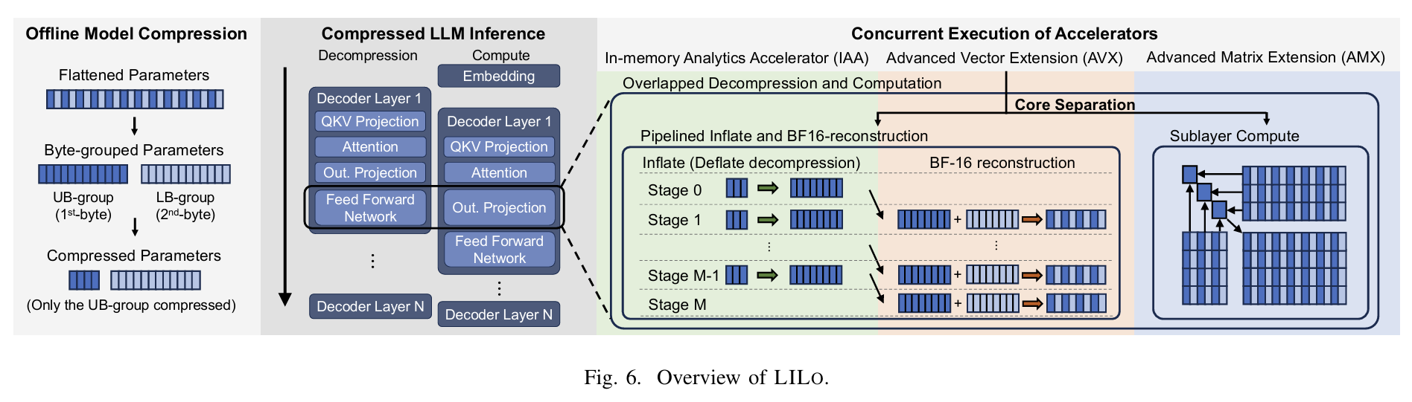
LILo Overall Architecture
Offline Model Compression (one-time)
Byte-grouping: Separate all UBs and LBs into two contiguous arrays
Selective compression: Compress only UB group with Deflate; leave LB group uncompressed
Online Inference (runtime)
IAA decompresses UB chunks
AVX reconstructs full BF16 values from UB and LB
AMX runs LLM inference
Key optimizations:
Pipelined IAA-AVX decompression
Sublayer-level decompression-compute overlap
Selective compression for MoE models

Slide 11
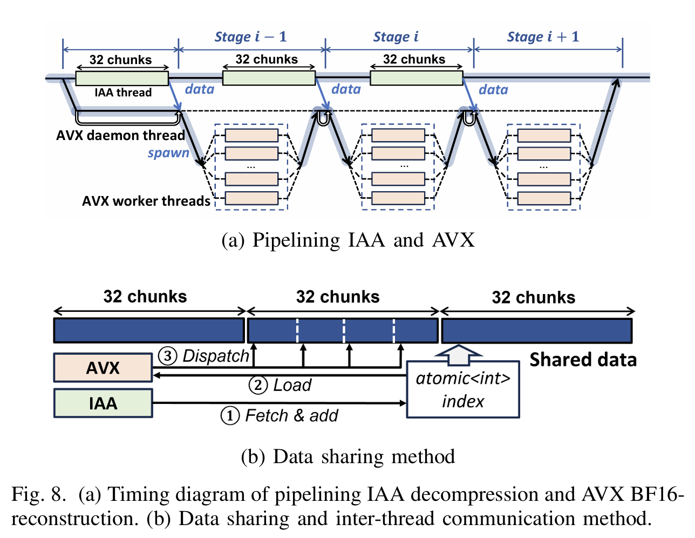
Innovation 1: Pipelined IAA-AVX Decompression
Task partitioning: Split UB into 1MB chunks → 32 chunks per pipeline stage (fully utilizes 32 IAA engines)
Pipeline execution:
Time t: IAA decompresses chunk i
Time t+1: IAA decompresses chunk i+1 while AVX reconstructs chunk i
Lock-free synchronization: Single atomic integer atomic_idx for inter-thread communication → zero synchronization overhead
Result: Decompression throughput increases from 16GB/s (CPU) to 153GB/s (9.3× speedup)

Slide 12
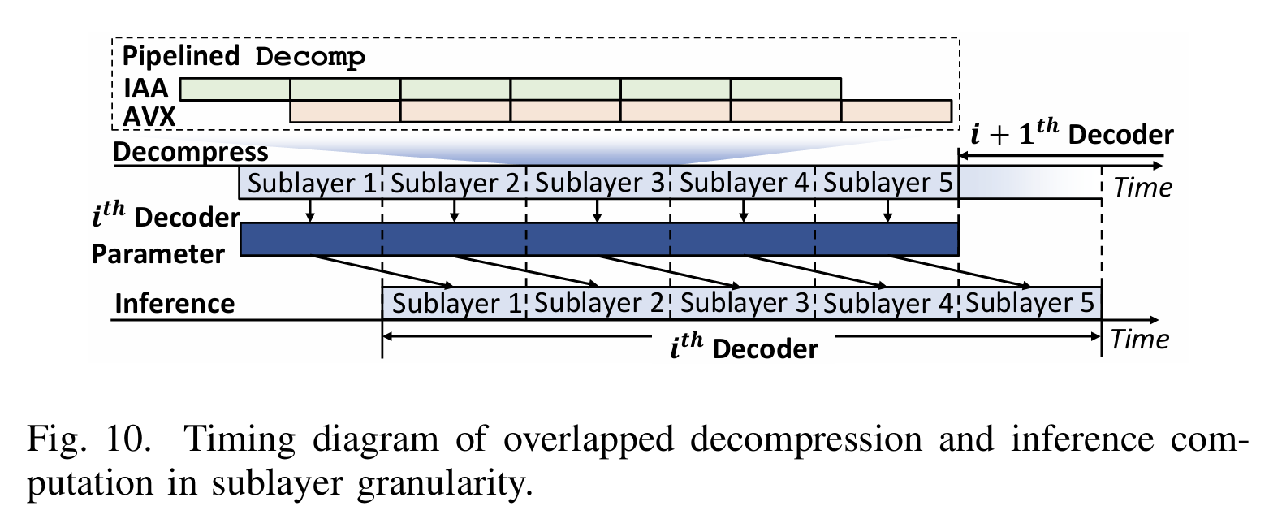
Innovation 2: Sublayer-Level Decompression-Compute Overlap
Core separation: Physically partition 128 CPU cores into three dedicated groups:
64 cores: AMX inference compute
63 cores: AVX BF16 reconstruction
1 core: IAA daemon thread
Sublayer-level overlap:
While AMX computes sublayer i, IAA+AVX decompress sublayer i+1 in the background
Advantages over layer-level overlap:
2× smaller buffer size
Reduced last-level cache contention
Decompression overhead is almost completely hidden

Slide 13
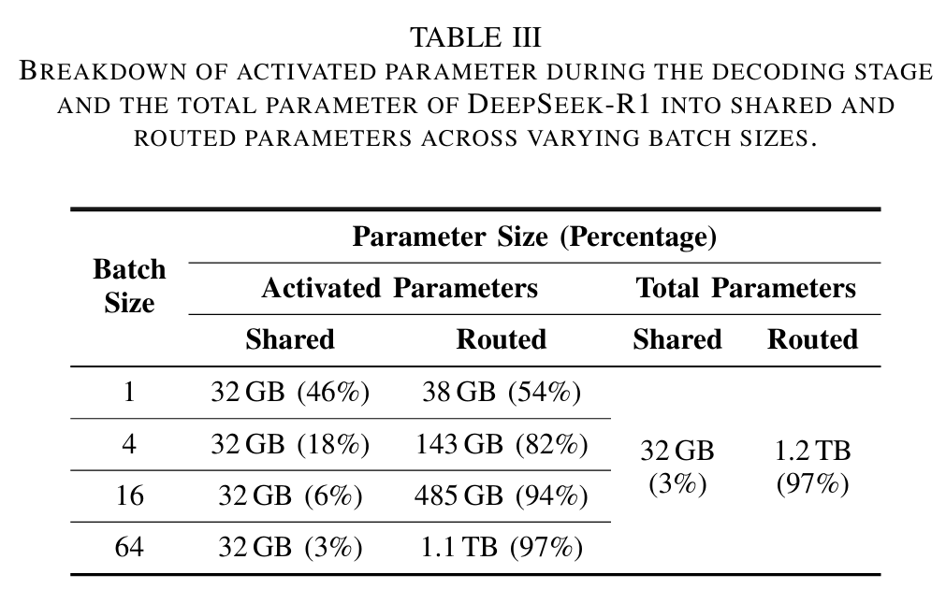
Innovation 3: Selective Compression for MoE Models
MoE parameter characteristics:
Shared parameters (3% of total): Used for every input → always accessed
Routed parameters (97% of total): Only a small subset is activated per input
Selective compression strategy:
Compress only routed parameters
Leave shared parameters uncompressed in memory
Result:
Decompression workload reduced by 1.9×
Compression ratio almost unchanged (67.5% → 68.3%)

Slide 14
Ⅳ Results

Slide 15
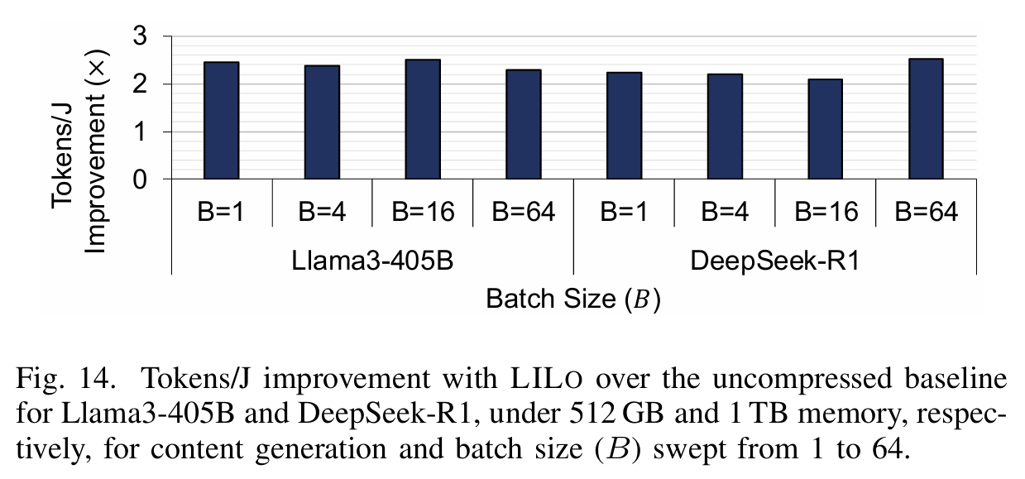
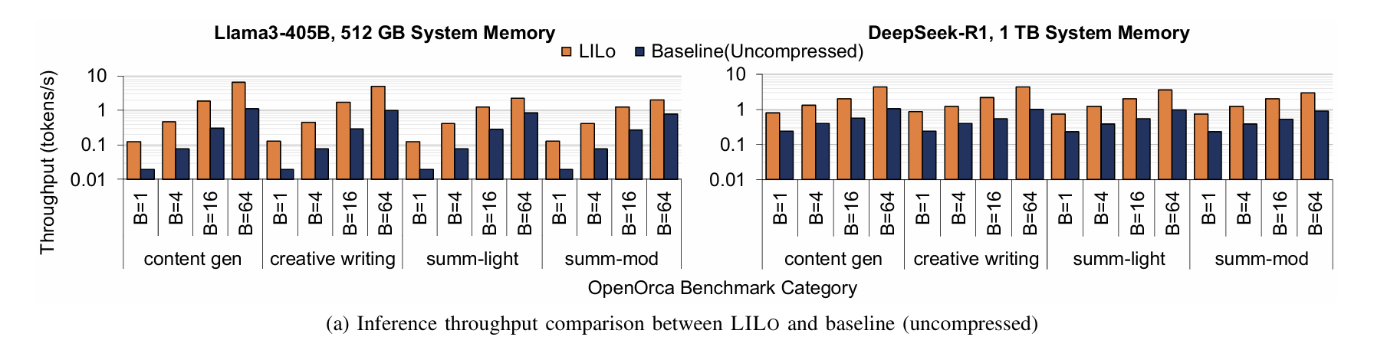
Core Performance Results
All results compared against uncompressed IPEX baseline (state-of-the-art CPU inference):
Llama3-405B (dense model, 512GB memory): 2.0–4.9× speedup → 4.9× at batch size 1 (single-user chat)
DeepSeek-R1 (MoE model, 1TB memory): 3.1–4.3× speedup → no storage offloading required, performance stable across all batch sizes
Generalization:
Qwen3-235B: 1.8–2.6× speedup
OPT-175B: 1.9–7.0× speedup
Energy efficiency: 2.1–2.5× improvement in tokens per joule

Slide 16
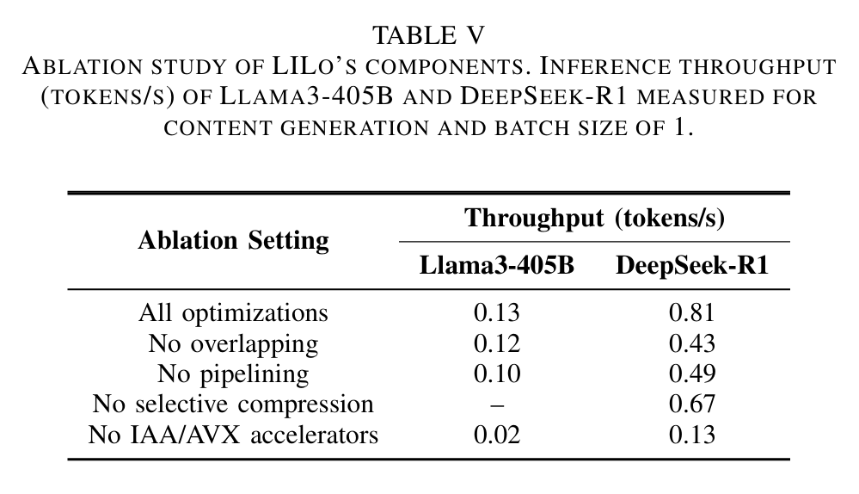
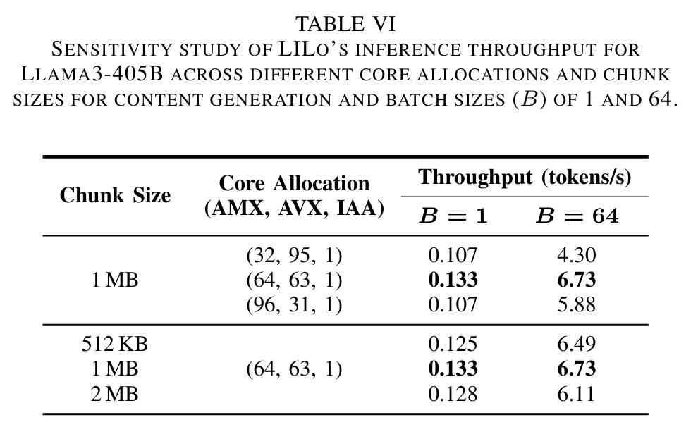
Ablation & Sensitivity Studies
Ablation study (batch size 1, no offloading):
Sensitivity study:
Optimal chunk size: 1MB (balances communication overhead and parallelism)
Optimal core allocation: (64, 63, 1) for AMX, AVX, IAA
Configuration | Llama3-405B Speedup | DeepSeek-R1 Speedup
All optimizations | 1.0× (baseline) | 1.0× (baseline)
No decompression-compute overlap | 0.9× | 0.53×
No IAA-AVX pipelining | 0.77× | 0.63×
No selective compression | - | 0.83×
No IAA/AVX accelerators | 0.16× | 0.16×

Slide 17
Ⅴ Conclusions

Slide 18
Summary, Contributions & Future Work
Key Contributions
First framework to orchestrate IAA, AVX, and AMX accelerators for compressed LLM inference on CPUs
Byte-grouped selective compression for BF16 parameters, achieving 33% lossless compression
Pipelined and overlapped execution that hides almost all decompression overhead
Selective compression optimized for MoE models, reducing decompression workload by 1.9×
Future Work
Dynamic selective compression: Identify and leave hot experts uncompressed
Extend to FP8 format and AMD CPU platforms
Native integration of storage offloading into IPEX

